Slide 1
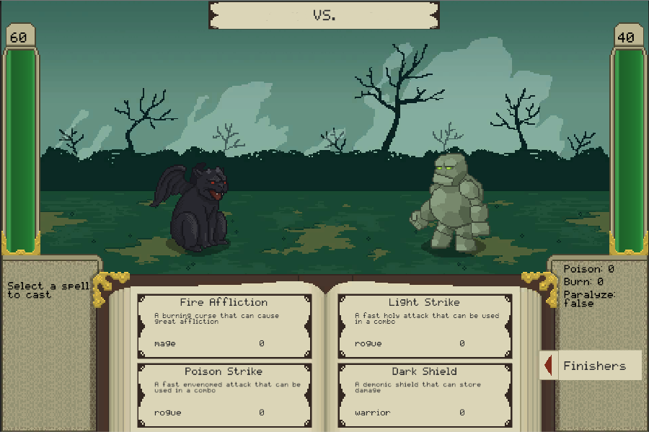
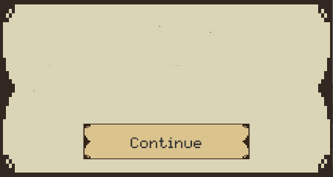
Player 1
Player 2
Welcome to the World of Grimoire,
Where you use a magical spell book
to control powerful summons.

Slide 2
Player 1
Player 2
Before you begin playing,
let’s have a quick run through of
how the game is played

Slide 3
Player 1
Player 2
The 4 marked buttons
are your current spells

Slide 4
Player 1
Player 2
Each spell has:

Slide 5
Player 1
Player 2
A name

Slide 6
Player 1
Player 2
A description that usually
indicates the spell’s abilities.

Slide 7
Player 1
Player 2
A cost,
that comes from
your own health points.

Slide 8
Player 1
Player 2
And finally a strategy type,
which includes:

Slide 9
Player 1
Player 2
A mage strategy:
focusing mainly
on dealing effects
to the opponent
(Such as Burn and Poison).

Slide 10
Player 1
Player 2
A Rouge strategy:
focusing mainly
on dealing physical damage
to the opponent.

Slide 11
Player 1
Player 2
Lastly,
The Warrior strategy:
focusing mainly
on storing damage and returning it to the opponent.

Slide 12
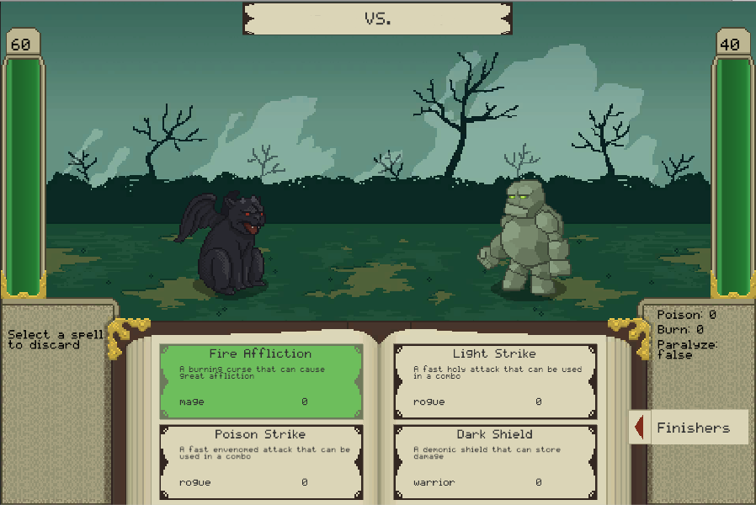
Player 1
Player 2
Once you have selected
your spell for the turn,
it will be highlighted in green,
confirming your selection.

Slide 13
Player 1
Player 2
You will then
need to choose 1 spell
to discard

Slide 14

Player 1
Player 2
The spell you chose to discard
will be highlighted in red.

Slide 15
Player 1
Player 2
Once you have made
Your selection
The battle phase
Will commence.

Slide 16
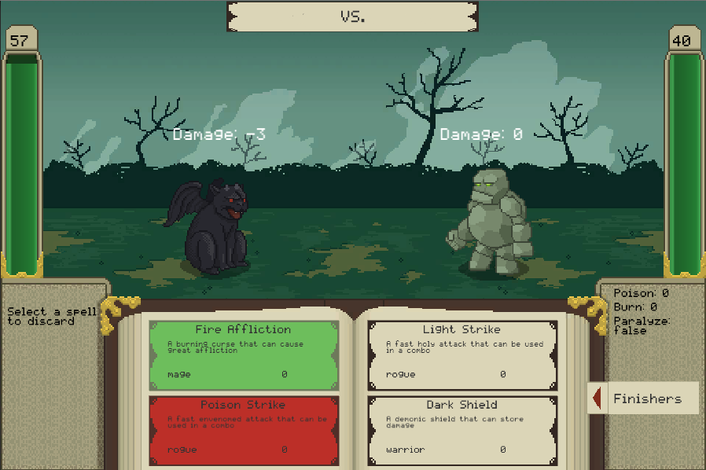
Player 1
Player 2
Any physical damage
you receive
will appear above
your head.

Slide 17
Player 1
Player 2
And any physical damage
they receive
will appear above
their head.

Slide 18
Player 1
Player 2
Additionally, any other damage
that has been inflicted to you
through an effect
will appear in the marked box.

Slide 19
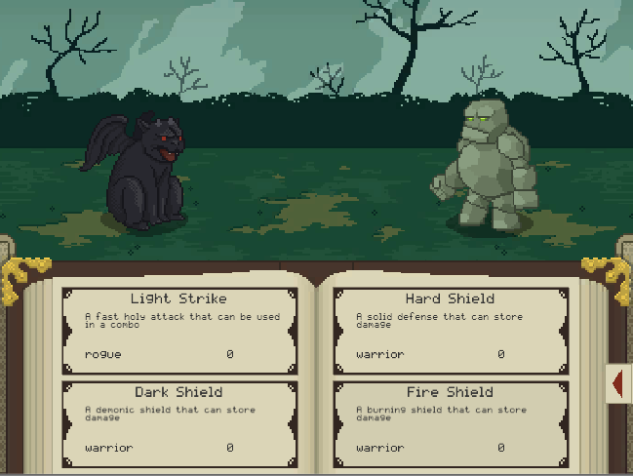
Player 1
Player 2
Once the Battle phase ends,
you will keep the two
other spells
you have not selected.

Slide 20
Player 1
Player 2
And will receive two new spells
as well.

Slide 21
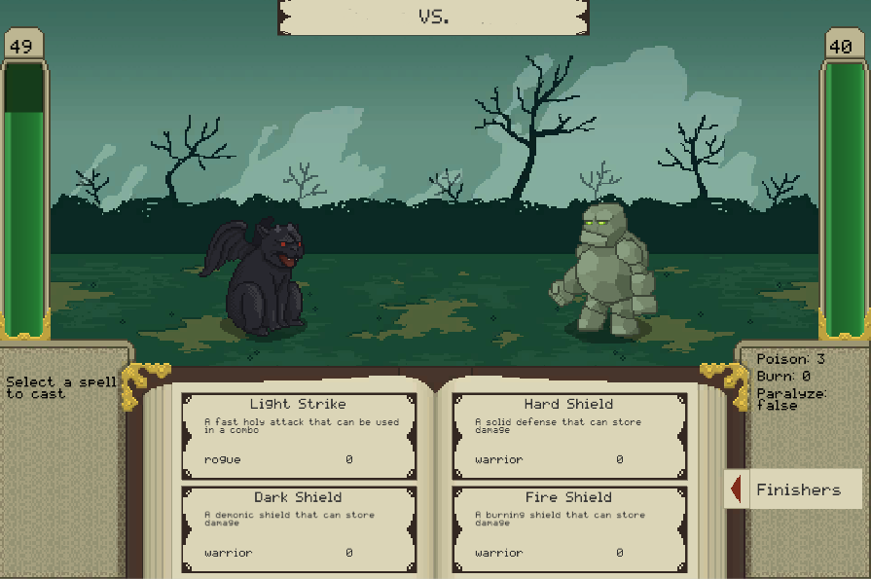
Player 1
Player 2
Lastly you have the option of
using a finisher by clicking
On the ‘Finishers’ Tab.

Slide 22
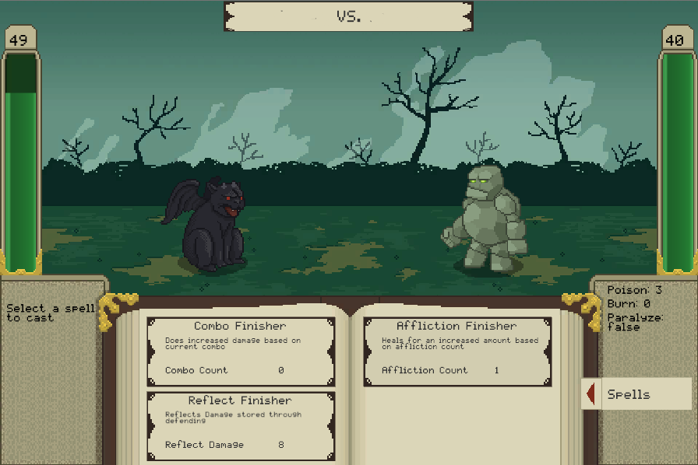
Player 1
Player 2
Your finishers build up
As you use the same strategy
Type Spells consistently.

Slide 23
Player 1
Player 2
The Combo Finisher builds up
When you use
Rouge type Spells.

Slide 24
Player 1
Player 2
The Affliction Finisher builds up
When you use
Mage type Spells.

Slide 25
Player 1
Player 2
The Reflect Finisher builds up
When you use
Warrior type Spells
and store damage.

Slide 26
Player 1
Player 2
That covers the rules
To the world of Grimoire.
Now go out there
and fight other summoners.

